Slide 1
ECE3403 - Data Analytics & Optimization
Section 4
Data Pre-processing and Cleaning
TAs
Marwan Nour
Yasmina Ayman
Hoda Osama

Slide 2
Data Normalization
normalization – a vital step in data preprocessing that ensures uniformity of the numerical magnitudes of features. This uniformity avoids the domination of features that have larger values compared to the other features or variables.
→ It’s used to to standardize and scale the data which is very important to ensure that every feature has an equal impact on the prediction in ML models.

Slide 3
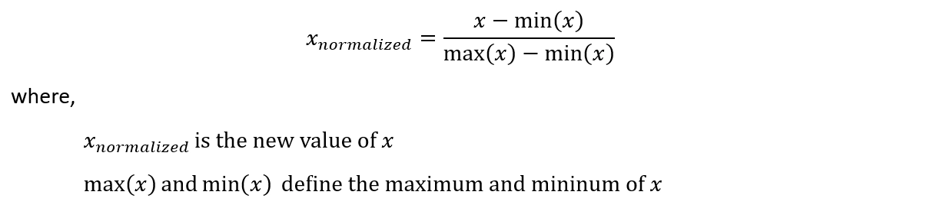
Min-Max Normalization
Min-max scaling is very often simply called ‘normalization.’ It transforms features to a specified range, typically between 0 and 1.
** Sensitive to outliers and the range of the data

Slide 4
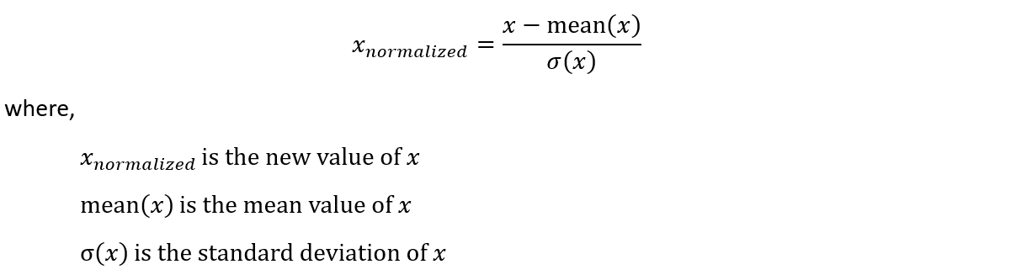
Z-Score Normalization (Standardization)
Z-score normalization (standardization) assumes a Gaussian (bell curve) distribution of the data and transforms features to have a mean (μ) of 0 and a standard deviation (σ) of 1.
** Less sensitive to outliers due to the use of the mean and standard deviation.

Slide 5
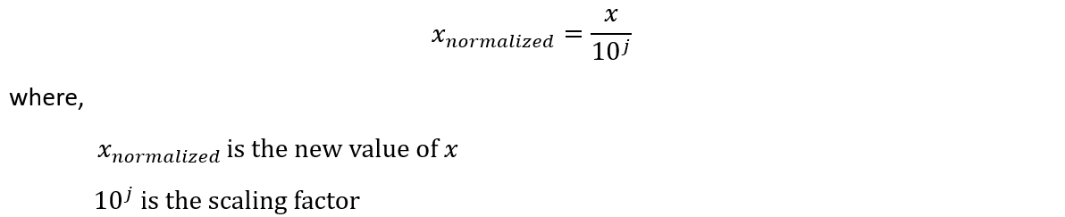
Decimal Scaling Normalization
The objective of decimal scaling normalization is to scale the feature values by a power of 10, ensuring that the largest absolute value in each feature becomes less than 1.
** It is particularly useful when the relative size or magnitude of the values is more important than their exact numerical scale.

Slide 6
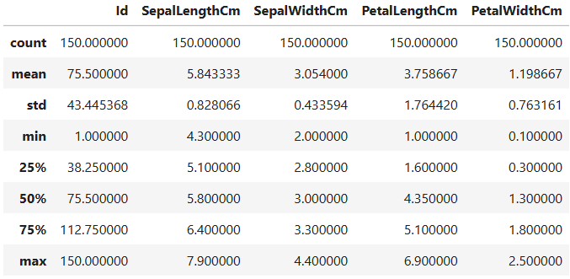
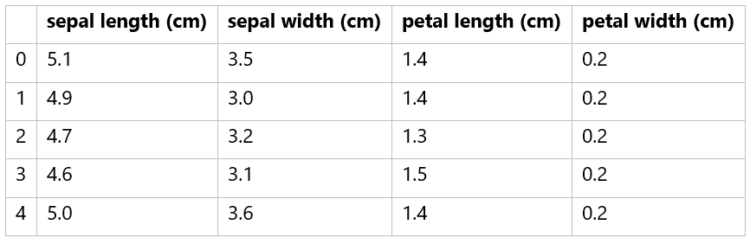
Question 2
Apply the following normalization techniques to the Iris dataset i (considering the statistics table of these attributes):
Min-Max Normalization
Z-score Normalization
Decimal Scaling Normalization

Slide 7

Question 2
Min-Max Normalization (Sepal length)
Sepal Length | Norm. sepal length
5.1 | 0.222
4.9 | 0.166
4.7 | 0.111
4.6 | 0.083
5 | 0.194

Slide 8
Question 2
Min-Max Normalization (Sepal width)
Sepal Width | Norm. sepal width
3.5 | 0.625
3.0 | 0.416
3.2 | 0.5
3.1 | 0.458
3.6 | 0.667

Slide 9
Question 2
Min-Max Normalization (Petal Length)
Petal Length | Norm. petal length
1.4 | 0.068
1.4 | 0.068
1.3 | 0.05
1.5 | 0.085
1.4 | 0.068

Slide 10
Question 2
Min-Max Normalization (Petal Width)
Petal Width | Norm. petal width
0.2 | 0.042
0.2 | 0.042
0.2 | 0.042
0.2 | 0.042
0.2 | 0.042

Slide 11
Question 2
Min-Max Normalization
Norm. sepal length | Norm. sepal width | Norm. petal length | Norm. petal width
0.222 | 0.625 | 0.068 | 0.042
0.166 | 0.416 | 0.068 | 0.042
0.111 | 0.5 | 0.05 | 0.042
0.083 | 0.458 | 0.085 | 0.042
0.194 | 0.667 | 0.068 | 0.042

Slide 12
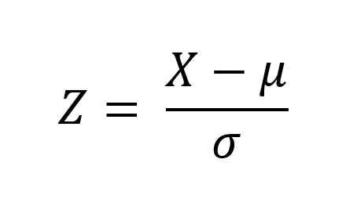
Question 2
2. Z-score Normalization (Sepal Length)
Sepal Length | Norm. sepal length
5.1 | -0.901
4.9 | -1.143
4.7 | -1.385
4.6 | -1.507
5 | -1.022

Slide 13
Question 2
2. Z-score Normalization (Sepal Width)
Sepal Width | Norm. sepal width
3.5 | 1.032
3.0 | -0.125
3.2 | 0.338
3.1 | 0.106
3.6 | 1.263

Slide 14
Question 2
2. Z-score Normalization (Petal Length)
Petal Length | Norm. petal length
1.4 | -1.341
1.4 | -1.341
1.3 | -1.398
1.5 | -1.284
1.4 | -1.341

Slide 15
Question 2
2. Z-score Normalization (Petal Width)
Petal Width | Norm. petal width
0.2 | -1.313
0.2 | -1.313
0.2 | -1.313
0.2 | -1.313
0.2 | -1.313

Slide 16
Question 2
2. Z-score Normalization
Norm. sepal length | Norm. sepal width | Norm. petal length | Norm. petal width
-0.901 | 1.032 | -1.341 | -1.313
-1.143 | -0.125 | -1.341 | -1.313
-1.385 | 0.338 | -1.398 | -1.313
-1.507 | 0.106 | -1.284 | -1.313
-1.022 | 1.263 | -1.341 | -1.313

Slide 17
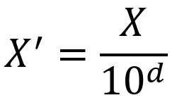
Question 2
3. Decimal Scaling Normalization (Sepal Length)
d = 1
Sepal Length | Norm. sepal length
5.1 | 0.51
4.9 | 0.49
4.7 | 0.47
4.6 | 0.46
5 | 0.5

Slide 18
Question 2
3. Decimal Scaling Normalization (Sepal Width)
d = 1
Sepal Width | Norm. sepal width
3.5 | 0.35
3.0 | 0.3
3.2 | 0.32
3.1 | 0.31
3.6 | 0.36

Slide 19
Question 2
3. Decimal Scaling Normalization (Petal Length)
d = 1
Petal Length | Norm. petal length
1.4 | 0.14
1.4 | 0.14
1.3 | 0.13
1.5 | 0.15
1.4 | 0.14

Slide 20
Question 2
3. Decimal Scaling Normalization (Petal Width)
d = 1
Petal Width | Norm. petal width
0.2 | 0.02
0.2 | 0.02
0.2 | 0.02
0.2 | 0.02
0.2 | 0.02

Slide 21
Question 2
2. Z-score Normalization
d = 1
Norm. sepal length | Norm. sepal width | Norm. petal length | Norm. petal width
0.51 | 0.35 | 0.14 | 0.02
0.49 | 0.3 | 0.14 | 0.02
0.47 | 0.32 | 0.13 | 0.02
0.46 | 0.31 | 0.15 | 0.02
0.5 | 0.36 | 0.14 | 0.02

Slide 22
Missing Data
Missing values are data points that are absent for a specific variable in a dataset. They can be represented in various ways, such as blank cells, null values, or special symbols like “NA” or “unknown.”
There are three main types of missing values:
Missing Completely at Random (MCAR)
Missing at Random (MAR)
Missing Not at Random (MNAR)

Slide 23
Missing Completely at Random (MCAR)
This happens if all the variables and observations have the same probability of being missing.
Example: A student’s height is missing in a school survey because the teacher accidentally dropped their form into a puddle.
Handling Missing Values Methods:
Listwise Deletion
Mean Imputation

Slide 24
Missing at Random (MAR)
The probability of the value being missing is related to the value of the variable or other variables in the dataset. This means that not all the observations and variables have the same chance of being missing.
Example:
In a survey, women are less likely to report their income, but the missingness depends only on their gender (observed), not on the actual income (unobserved).
Handling Missing Values Methods:
Multiple Imputation
Maximum likelihood Estimation

Slide 25
Missing Not at Random (MNAR)
It is applied when neither MAR nor MCAR apply. In this situation, the probability of being missing is completely different for different values of the same variable, and these reasons can be unknown to us.
Example:
In a health survey, individuals with poor mental health are less likely to report their mental health status. The missingness is directly related to the unobserved mental health condition.
Handling Missing Values Methods:
As the main reason for missingness of data are not captured, the traditional imputation methods may not be suitable and specialized techniques that consider the reasons for missingness are required.

Slide 26
Question 3
For each of the following examples:
Identify the type of missing data (MCAR, MAR, or MNAR).
Propose an appropriate approach to handle the missing data manually.
Implement the same approach using Python.

Slide 27
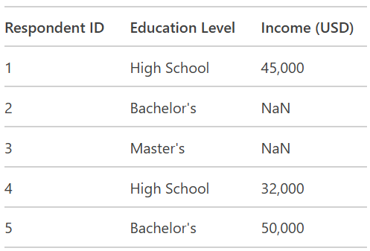
Question 3
Example 1: Survey Dataset (Missing Income Data)

Slide 28
Question 3
Example 1: Survey Dataset (Missing Income Data)
Missing values in the "Income" column are more common for respondents with higher education levels (MAR - Missing at Random).
Reason: Missingness is related to the observed data (higher education levels).

Slide 29
Question 3
Example 1: Survey Dataset (Missing Income Data)
Handle missing values using conditional mean imputation: Replace missing "Income" values with the mean income of respondents with the same education level.
Mean income for Bachelor's =
50,000/1 = 50,000
Mean income for Master's: No data available, so use the overall mean income.
(45,000+32,000+50,000+50,000)/4 = 44,250

Slide 30
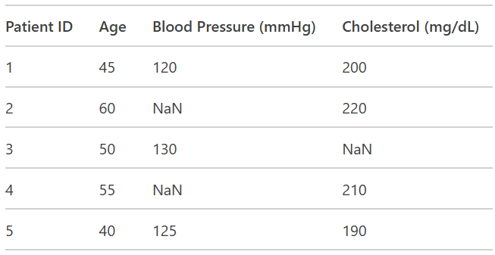
Question 3
Example 2: Medical Dataset (Missing Blood Pressure Data)

Slide 31
Question 3
Example 2: Medical Dataset (Missing Blood Pressure Data)
Missing values in the "Blood Pressure" column are randomly distributed (MCAR - Missing Completely at Random).
Reason: Missingness is random and not related to any observed or unobserved data.

Slide 32
Question 3
Example 2: Medical Dataset (Missing Blood Pressure Data)
Handle missing values using mean imputation: Replace missing "Blood Pressure" and “Cholesterol” values with the mean of the observed values.
Mean blood pressure =
120+130+125/3 = 125
Mean cholesterol =
200+220+210+190/4 = 205

Slide 33
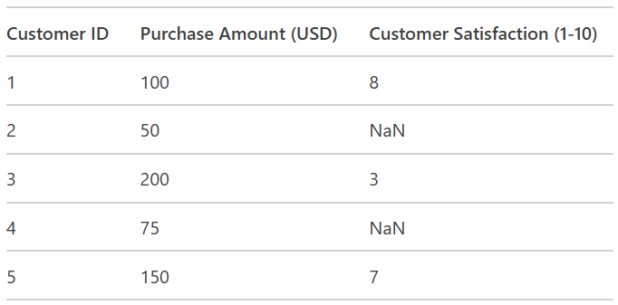
Question 3
Example 3: Customer Dataset (Missing Satisfaction Data)

Slide 34
Question 3
Example 3: Customer Dataset (Missing Satisfaction Data)
Missing values in the "Customer Satisfaction" column are more common for customers with lower purchase amounts or negative experiences (MNAR - Missing Not at Random).
Reason: Missingness is related to unobserved data (e.g., customers with negative experiences are less likely to respond).

Slide 35
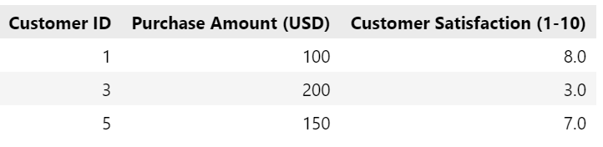
Question 3
Example 3: Customer Dataset (Missing Satisfaction Data)
Handle missing values using Listwise Deletion: Remove rows where "Customer Satisfaction" is missing. This is a simple approach but should only be used if the missing data is minimal and does not bias the remaining dataset.

Slide 36
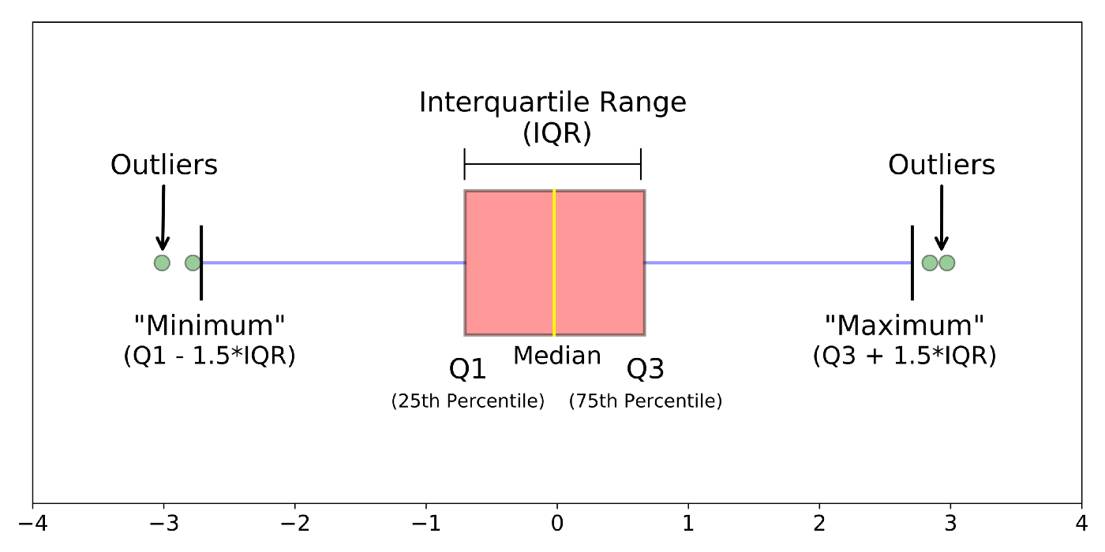
Outliers
Outliers are extreme data values that do not fit with the general pattern of the data. They can come from extreme events or from mistakes in the data collection.
Detecting Outliers:
Interquartile Range and Boxplot

Slide 37
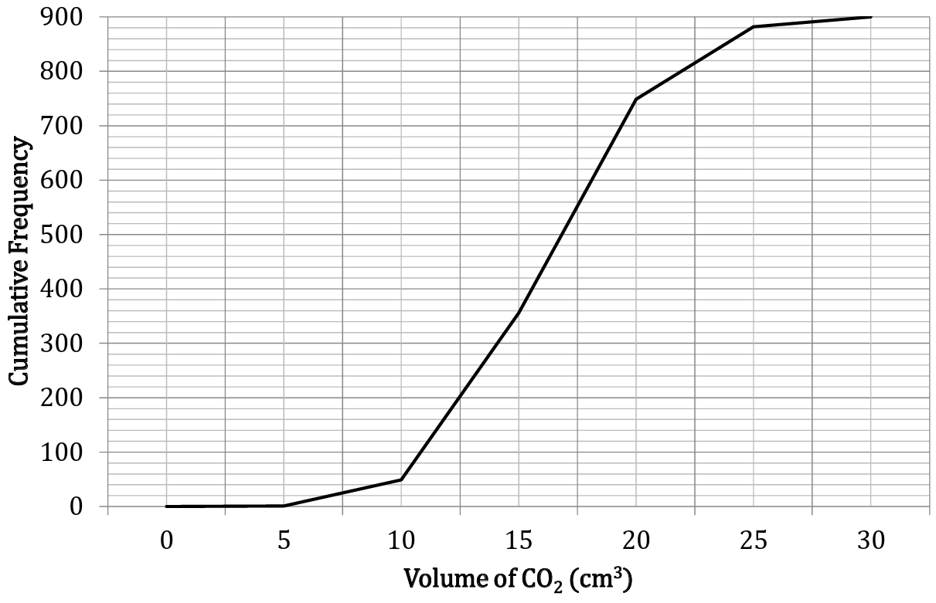
Question 4
The volume of 𝑪𝑶𝟐 a machine produces was measured 900 times in June. These volumes are displayed in the cumulative frequency graph below.
Estimate the median and interquartile range of the data
Identify the outliers, if there are any.
Discuss whether these outliers should be removed.
On the next six occasions, the machine reported negative values. Discuss how adding these into the data would alter the graph.

Slide 38
Question 4
Estimate the median and interquartile range of the data
The median is found at the 50th percentile (half of the total frequency).
The approximate median volume of CO₂ is ≈ 17 cm³.

Slide 39
Question 4
Estimate the median and interquartile range of the data
The lower quartile (Q1) is at 25% of the total frequency (900 ÷ 4 = 225)
The upper quartile (Q3) is at 75% of the total frequency (3 × 900 ÷ 4 = 675)
Q1 ≈ 13 cm³
Q3 ≈ 18 cm³
IQR = Q3 - Q1 = 18 - 13 = 5

Slide 40
Question 4
Identify the outliers, if there are any.
Outliers can be found using the
1.5 × IQR rule
Lower boundary:
Q1 - 1.5 × IQR = 13 - 1.5(5) = 5.5
Upper boundary:
Q3 + 1.5 × IQR = 18 + 1.5(5) = 25.5
→ all values above 25.5 could be considered outliers, and all values below 5.5 are outliers

Slide 41
Question 4
Discuss whether these outliers should be removed.
If they result from measurement errors or malfunctions, they should be removed.
If they represent natural variation, they should be kept.

Slide 42
Question 4
On the next six occasions, the machine reported negative values. Discuss how adding these into the data would alter the graph.
No. These outliers are because of an error in the machine, or the person recording the reading, since negative CO₂ volume may be unrealistic.

Slide 43
Thanks!
Do you have any questions?

